Slide 1

Indexing

Slide 2
Basic Concepts
Indexing is a way to optimize performance of a database by minimizing the number of disk accesses required when a query is processed.
Indexing mechanisms used to speed up access to desired data.
E.g., author catalog in library
Search Key - attribute to set of attributes used to look up records in a file.
An index file consists of records (called index entries) of the form
Index files are typically much smaller than the original file
Two basic kinds of indices:
Ordered indices: search keys are stored in sorted order
Hash indices: search keys are distributed uniformly across “buckets” using a “hash function”.
search-key
pointer

Slide 3
Index Evaluation Metrics
Access types supported efficiently. E.g.,
records with a specified value in the attribute
or records with an attribute value falling in a specified range of values.
Access time
Insertion time
Deletion time
Space overhead

Slide 4
Ordered Indices
In an ordered index, index entries are stored sorted on the search key value. E.g., author catalog in library.
Primary index: in a sequentially ordered file, the index whose search key specifies the sequential order of the file.
Also called clustering index
The search key of a primary index is usually but not necessarily the primary key.
The primary index is classified into two types: Dense Index and Sparse Index.
Secondary index: an index whose search key specifies an order different from the sequential order of the file. Also called non-clustering index.

Slide 5
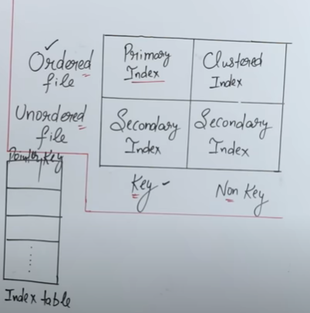
Key | Pointer
1
2
3
4
E_ID | Name | D_No
1 | A | 1
2 | B | 1
3 | A | 1
4 | C | 2
5 | B | 2
6 | A | 3
7 | D | 3
8 | E | 3
9 | D | 4

Slide 6
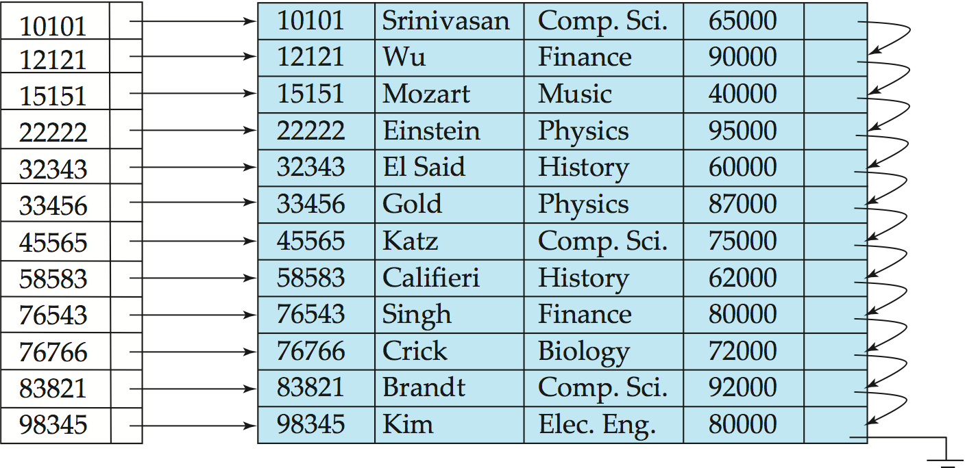
Dense Index Files
Dense index — Index record appears for every search-key value in the file.
E.g. index on ID attribute of instructor relation

Slide 7
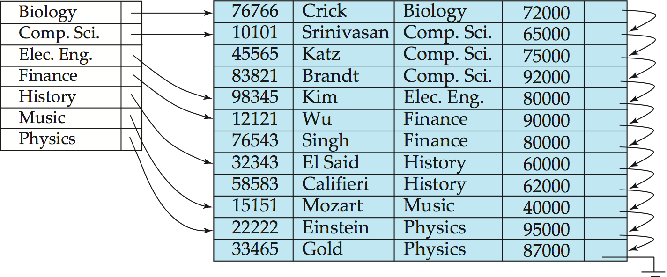
Dense Index Files (Cont.)
Dense index on dept_name, with instructor file sorted on dept_name

Slide 8
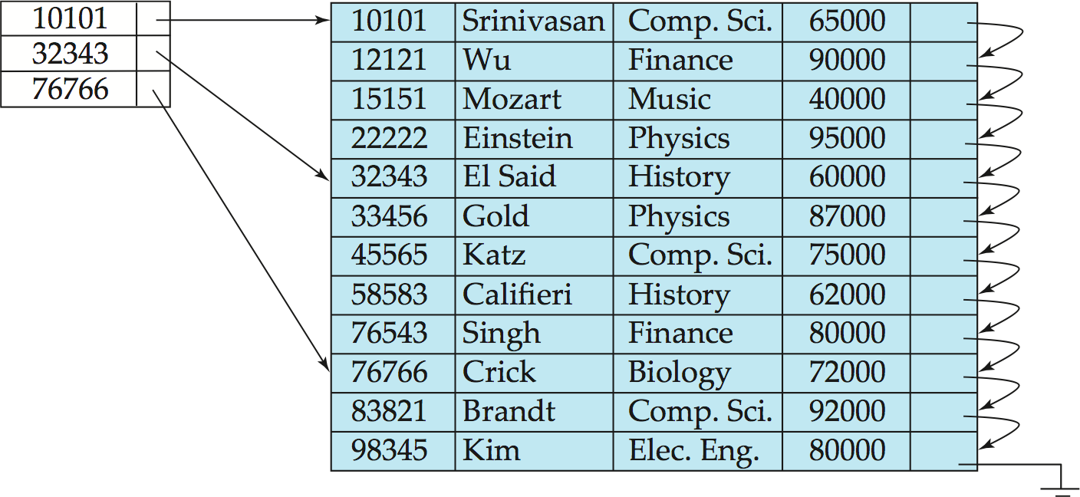
Sparse Index Files
Sparse Index: contains index records for only some search-key values.
Applicable when records are sequentially ordered on search-key
To locate a record with search-key value K we:
Find index record with largest search-key value < K
Search file sequentially starting at the record to which the index record points

Slide 9
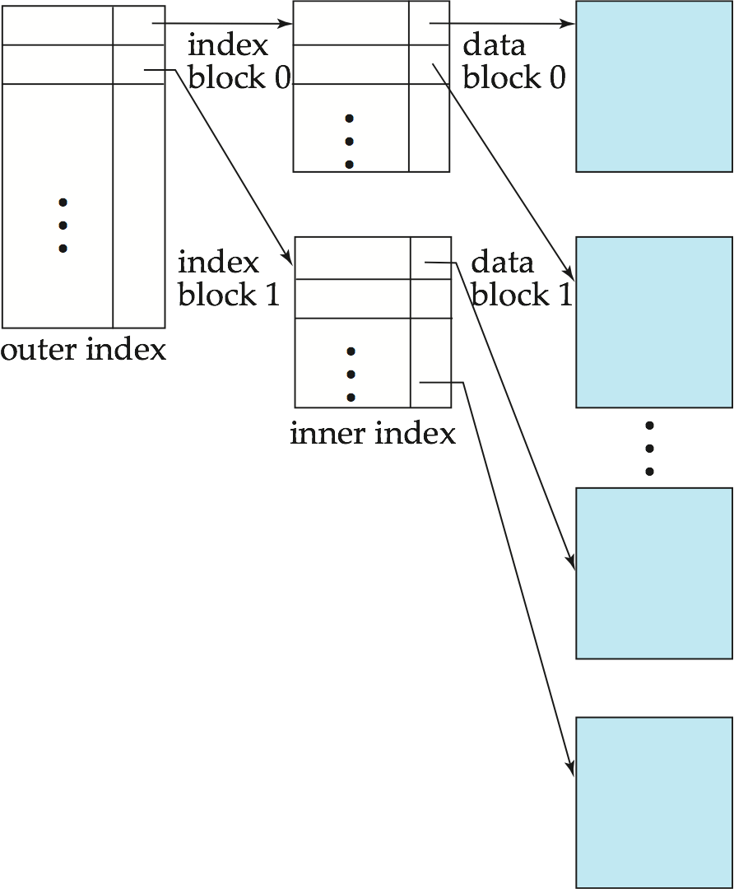
Sparse Index Files (Cont.)
Compared to dense indices:
Less space and less maintenance overhead for insertions and deletions.
Generally slower than dense index for locating records.
Good tradeoff: sparse index with an index entry for every block in file, corresponding to least search-key value in the block.

Slide 10
Secondary Indices Example
Secondary index on salary field of instructor
Index record points to a bucket that contains pointers to all the actual records with that particular search-key value.
Secondary indices have to be dense
Notes:
10

Slide 11
E_ID | Name | D_No
1 | A | 1
2 | B | 1
3 | A | 1
4 | C | 2
5 | B | 2
6 | A | 3
7 | D | 3
8 | E | 3
9 | D | 4
Key | Pointer
A
B
C
D
E
A | A | A
B | B

Slide 12
Primary and Secondary Indices
Indices offer substantial benefits when searching for records.
BUT: Updating indices imposes overhead on database modification --when a file is modified, every index on the file must be updated,
Sequential scan using primary index is efficient, but a sequential scan using a secondary index is expensive
Notes:
12

Slide 13
Multilevel Index
If primary index does not fit in memory, access becomes expensive.
Solution: treat primary index kept on disk as a sequential file and construct a sparse index on it.
outer index – a sparse index of primary index
inner index – the primary index file
If even outer index is too large to fit in main memory, yet another level of index can be created, and so on.
Indices at all levels must be updated on insertion or deletion from the file.

Slide 14
Multilevel Index (Cont.)

